Slide 1


Slide 2
Synopsis
Data Health Check
Identifies the Health of the Data, where the input data sets/streams are analysed on several dimensions for suitability of end use in the project
Highly functional, user-friendly Pyspark based solution which can extract the data from heterogeneous sources and profile the datasets using automated manners.
Below are the key aspects of the solution
Capability of Data extraction from heterogeneous sources (5 sources)
Automated and reusable approach for Data Profiling
Entire solution built on Open Source tools (Spark SQL, python and python libraries).
Used Matplotlib and Seaborn libraries for Visualization

Slide 3
Problem Being Solved
Data extracted from below heterogeneous data sources and stored as data frame. Calculated Health index at table level, compared the stats at column level and Visualization created.
In scope:
CSV
JSON
ORC
PARQUET
MySQL (For other databases, necessary jdbc connectors to be included)
Out of Scope:
Source not mentioned in In scope
Note:
It is easy to include different sources, similar to the in-scope items

Slide 4
Technology/Tool/Stack
Pyspark
Python
Matplotlib, Seaborn libraries for Data Visualization

Slide 5
Solution Architecture
db.ini
4
ingest.py
3
Config.ini
2
5
1
data_pipeline.py
6
transform.py
7
User submits the job
Read configuration file
Pass Input details (file format, path, primary key
Read db properties (if input is db)
File/db read, converts as DataFrame and passed it to data_pipeline
Sends DataFrame for Health check
Performs Health check and send details
Sends health check details for Creating reports, plots and charts
Saves reports, plots and charts
8
Reports, plots and charts
persist.py
9

Slide 6
Solution Architecture
Defined functions to calculate value of each health index
It expects user’s input for the source type, source file path and primary key in config.ini
In case of databases, user should provide the details of url, table name, user name and password in another config file db.ini
If the source has primary key, user should provide primary key too in the config file as comma separated values
On running this program, data from source is converted in to spark data frame
All the health index is calculated by calling the functions internally.
Bar chart is generated and saved for Table health
Heat map and Line chart are generated to compare the details at column level
Below is the databricks URL to view the code and the output
https://databricks-prod-cloudfront.cloud.databricks.com/public/4027ec902e239c93eaaa8714f173bcfc/1689922132651787/3273963528173652/5432158817586684/latest.html

Slide 7
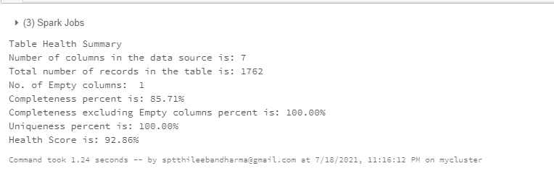
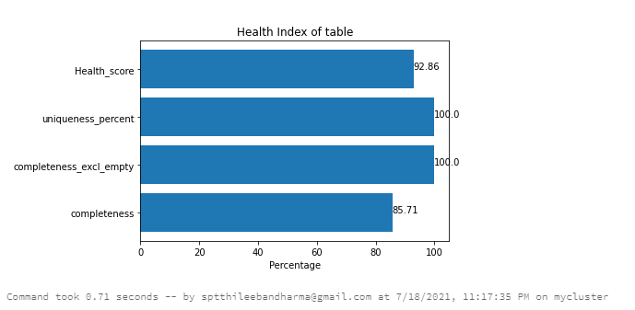
Demo Screenshots

Slide 8
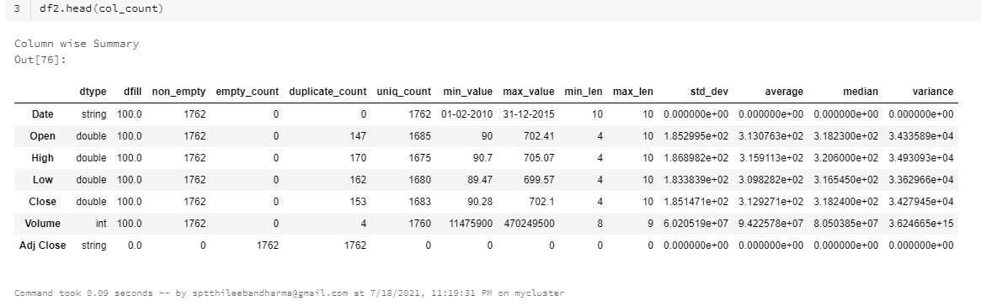
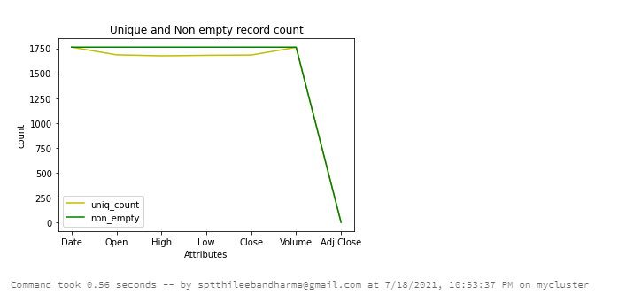
Demo Screenshots

Slide 9
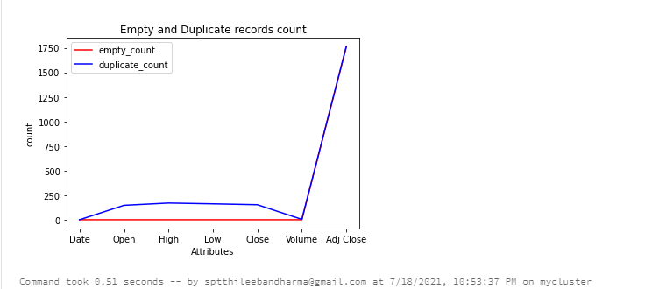
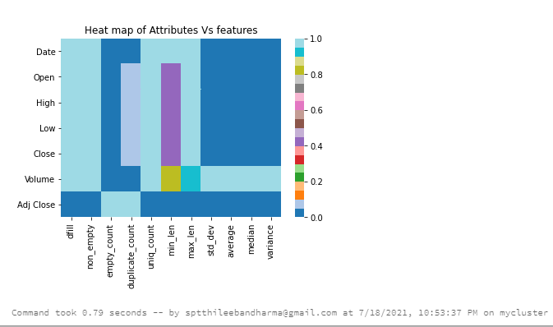
Demo Screenshots

Slide 10
Challenges Faced
Used data-bricks to build this solution with single cluster, Code to get user input in data bricks is different from regular python codes.
Setting up Spark environment in personal laptop for enhancing the code in Pycharm IDE
Installing MySQL connector
Though building data acquisition from variety of sources is similar, not able to include all due to local environment restrictions
Creating the plot when attributes are in higher number

Slide 11
Future enhancements
1
Heterogeneous Data source
Now included 5 sources only. In future enhancements multiple source will be included
2
Visualization
i) Correcting the labels in plots
ii) Now it has graphs and charts with details. In future release interactive dashboard will be built using Plotly and flask
3
Unit testing
Yet to include Unit testing framework

Slide 12
Thank You
Thileeban Dharma T

